Slide 1
UNIT 3-ASSOCIATIVE LEARNING-UNIT 3
Prof. Shilpa Gaikwad
TE AIDS

Slide 2
Introduction
Motivation of Learning:
Learning new content and constantly adapting to the circumstances is fundamental in all life stages.
Small exercise
Try to recall an old story or story of a movie watched in the past.
Or
Recall memory of some old trip.

Slide 3
Associative learning
Learning where new response becomes linked to particular stimulus.
Learning from association or relating several things.
There are two ways to define Associative learning:
1.Based on two stimulus:
Learning that occurs when two stimulus are associated.
Example-Lightning-thunder
Lightning and thunder are two stimulus which will cause rain (response).If one stimulus is absent either lightning is absent or thunder is absent, then also you can guess it may rain.
This is classical conditioning.

Slide 4
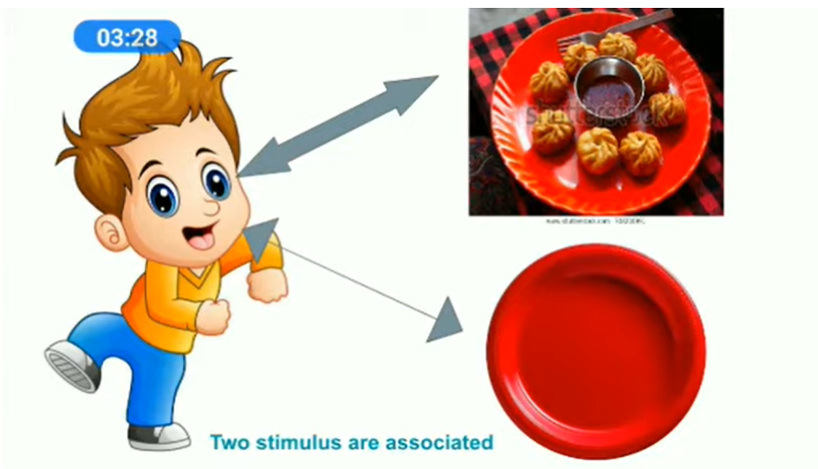

Slide 5
Associative learning
For example- You like to eat momos and you always eat momos served in a red plate.
After some time when you see the red plate you will start thinking of momos.
So the first stimulus is momos, main attraction and the other stimulus is red plate.
And they both are linked for your response or your behavior.
This type of learning is called Associative learning.

Slide 6
Associative learning
2.Based on behavior consequences/outcomes
Learning that occurs when we make an association between a response/behavior and its consequences/outcomes.
For example:
Fire-burn
Naughty-punished
Chilly-bitter
Fire is related to burning so one must avoid getting close to fire, a naughty person should be punished so that next time he doesn’t repeat troubling others. If you eat chilly you will get a bitter taste so you try to avoid it. This is also called operant conditioning.
Experience comes with reward and punishment.

Slide 7
Associative learning
Associative learning is a method or process wherein the learner associates a certain response to an object or stimulus resulting in a positive or negative outcome.
How do punishments and rewards affect us?

Slide 8
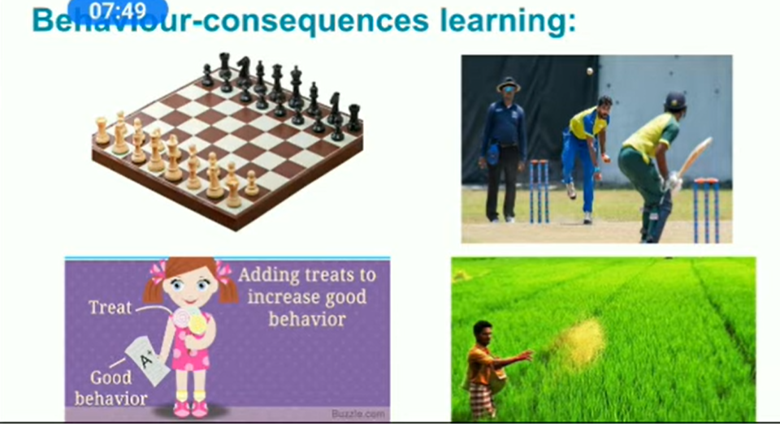
Behaviour – consequences learning

Slide 9
Associative learning
For Example :
If a chess player makes a move and his/her move doesn’t get any advantage/reward then next time he/she will not make that move.
Suppose in a cricket match, if a baller puts a full toss and the batsman hits a sixer ,so next time the baller wont repeat his action of putting a full toss, he will try to put different ball with which he can take the batsman wicket.
So he is learning from his mistakes.
If a school girl gets good grades her parents will give her a treat but if her grades are not satisfactory then she might get scolded by her parents.
If a farmer has sown seeds in his field for which he doesn’t get any productivity or profit, so next time he will put another seeds and grow any other vegetables.
So he is learning from his experiences.

Slide 10
Associative learning
Our experiences teach us what benefits us and what is beneficial/harmful to us.
We increase frequency of repletion of task with rewards and benefits and reduce frequency of tasks with punishments.

